Slide 1

Bike Wale

Slide 2
About Us:
Name: Vamshi Krishna
Qualification :B.Tech
Name: Venakata Charan
Qualification : Btech

Slide 3
Problem Statement
The problem at hand is to gather data on various bikes from a website and analyze their attributes to understand the factors influencing their popularity and performance.
Project Overview:
The project aims to analyze data related to bikes, including their features such as price, ratings, cubic capacity, kilometers per liter, horsepower, and weight. The goal is to derive insights from the data and visualize various relationships between these features.
Objective:
To analyze the relationship between bike attributes (brand, price, engine specifications, etc.) and their ratings.
To identify key factors influencing the popularity and performance of bikes.
To provide insights for consumers, manufacturers, and enthusiasts in the motorcycle industry.
With this problem statement, we aim to extract meaningful insights from the collected data to better understand the dynamics of the bike market and provide valuable information for various stakeholders.

Slide 4
Contents:
Tools
Website for web-Scrapping
Raw Data
Data Cleaning and Data Manipulation
Cleaned Data
EDA
Conclusion

Slide 5
Libraries used:
Requests
Beautiful Soup
Pandas
NumPy
Matplotlib
Seaborn

Slide 6
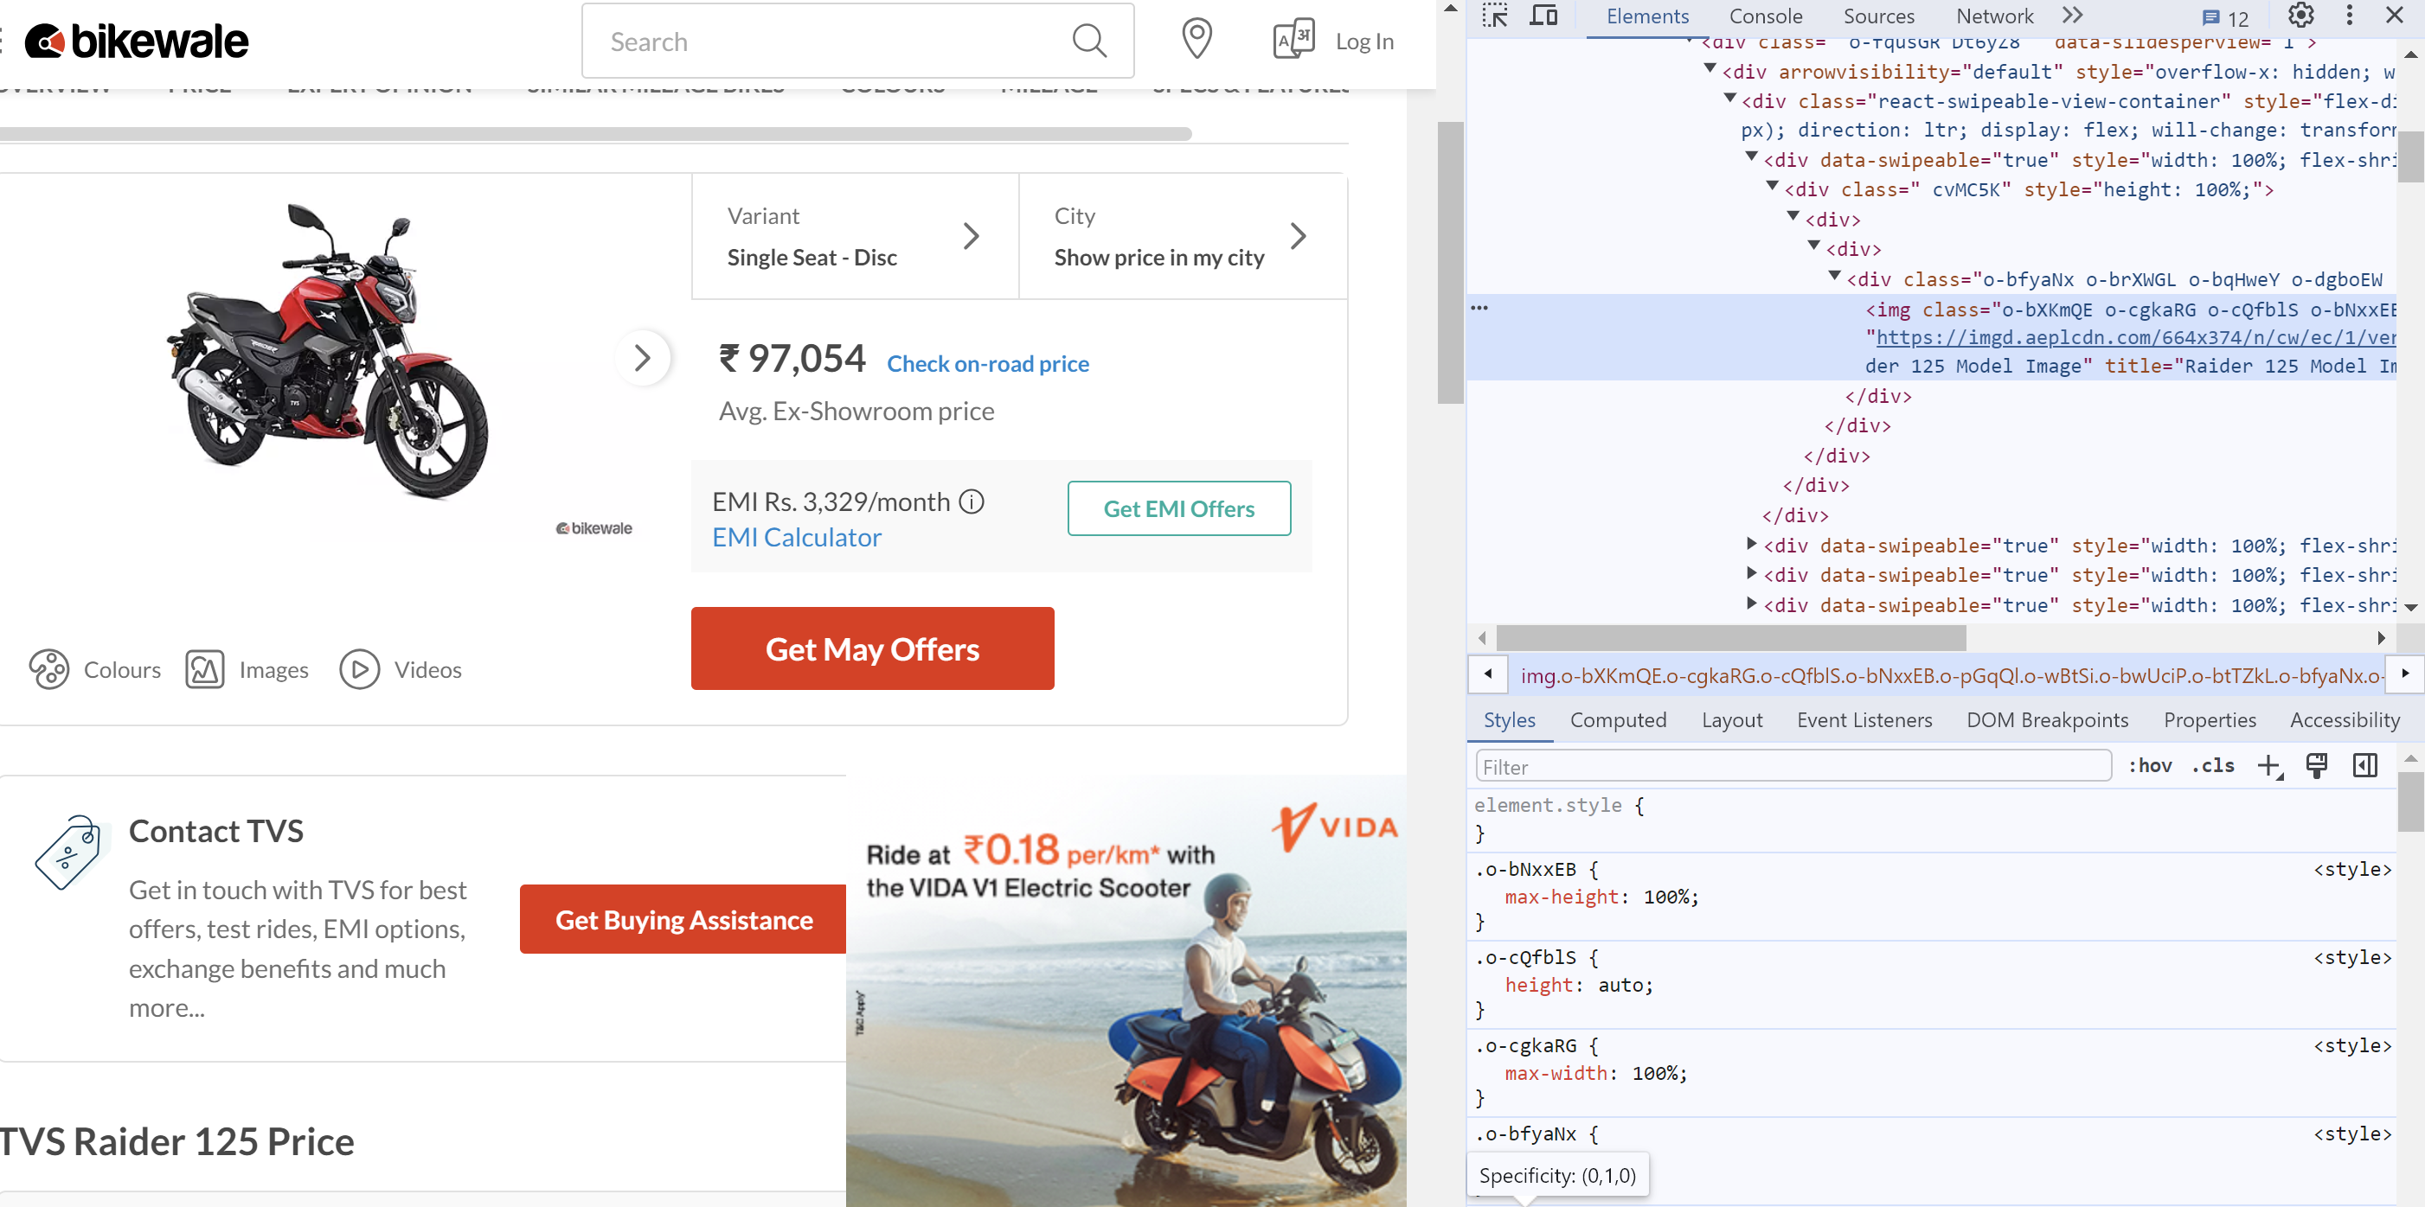
INTERFACE OF THE WEBSITE ALONG WITH THE HTML

Slide 7
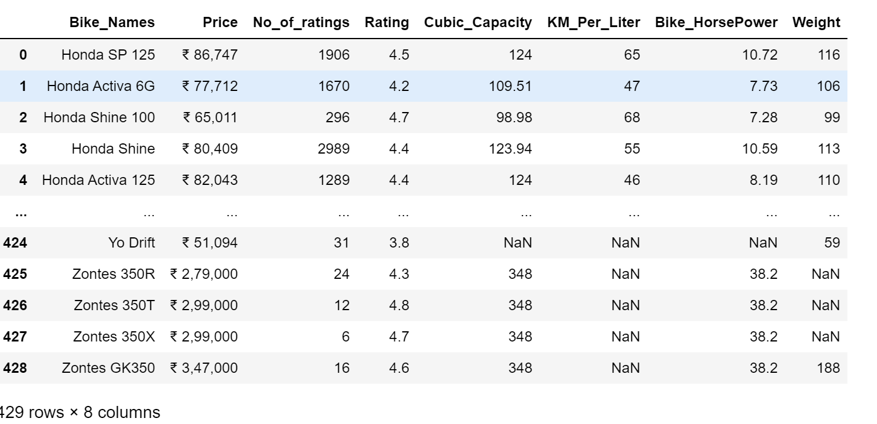
Raw Data

Slide 8
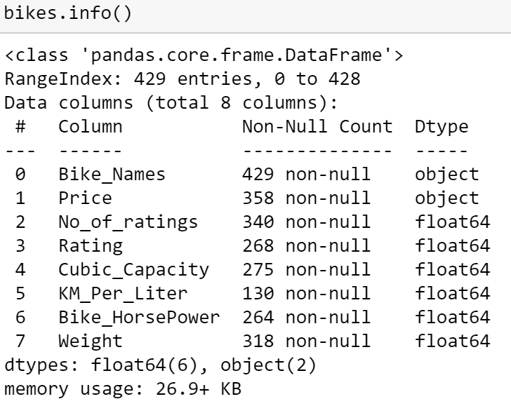
Raw Data Info()

Slide 9
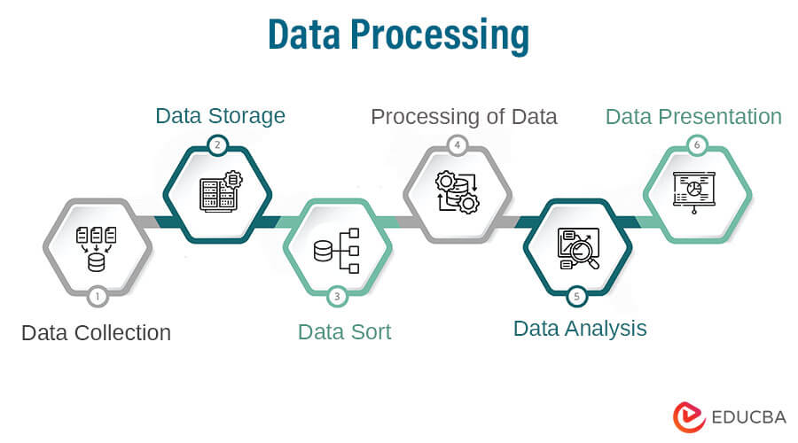

Slide 10
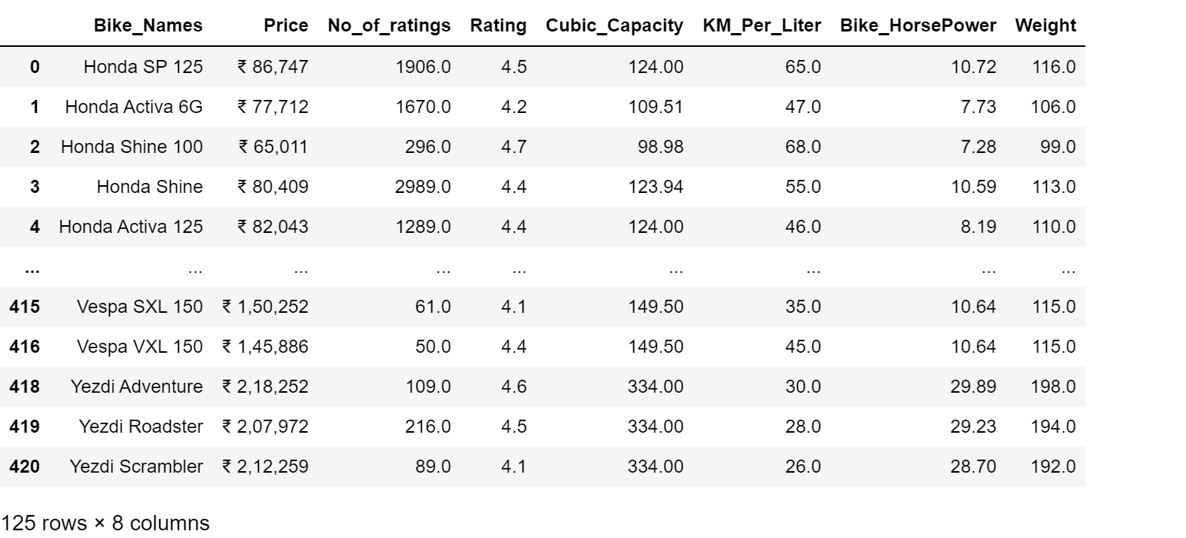
Cleaned Data

Slide 11
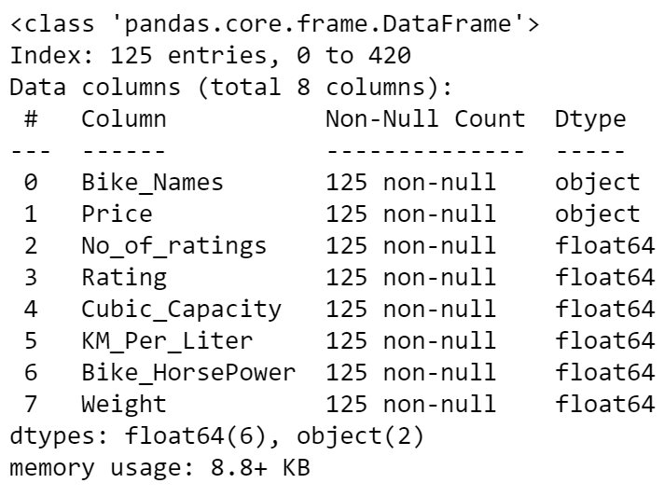
Cleaned Data Info()

Slide 12
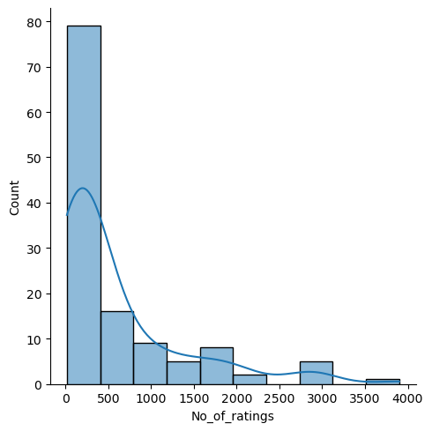
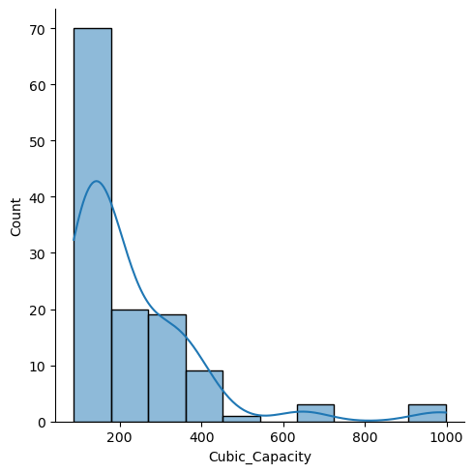
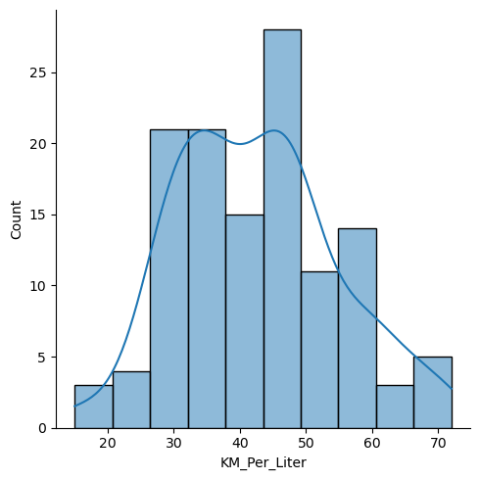
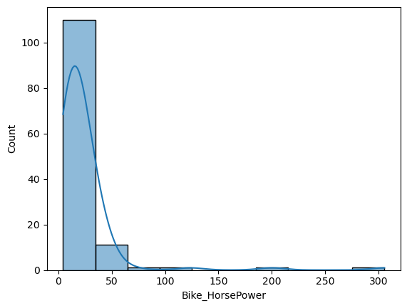
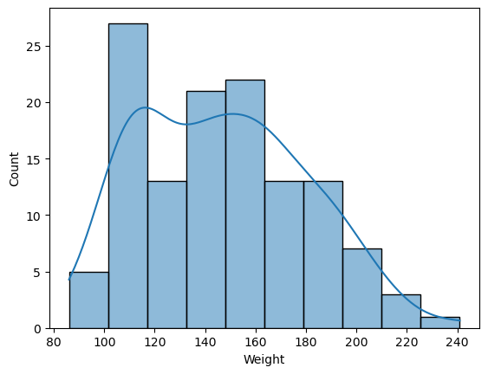
UNI VARIANT

Slide 13
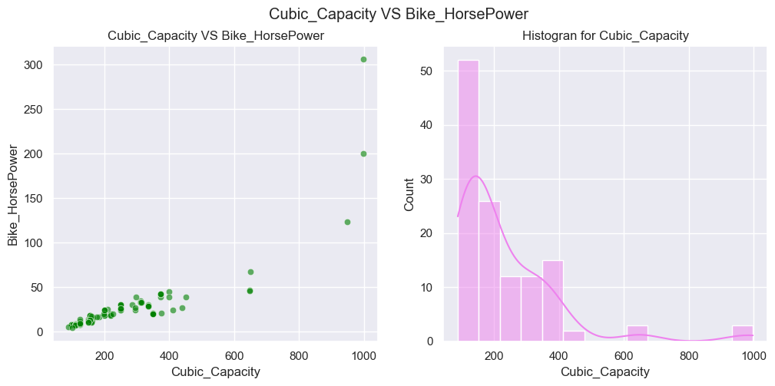
Bi-VARIANT

Slide 14
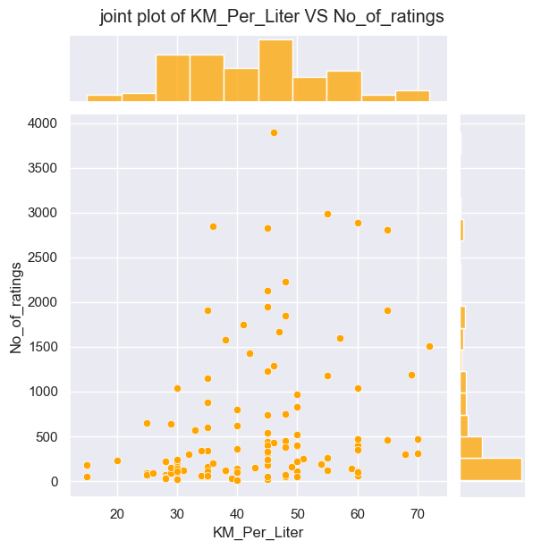

Slide 15
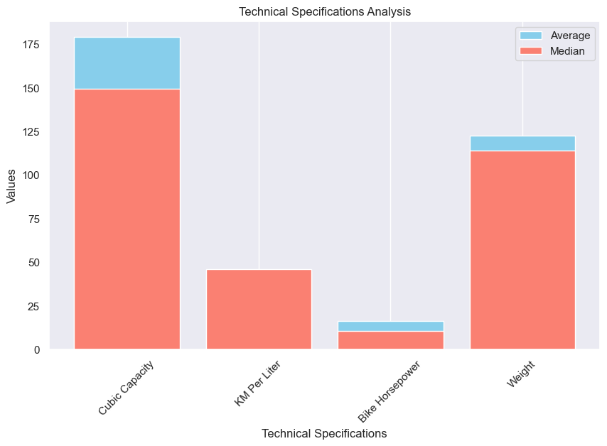
Technical Specifications Analysis:
*Cubic Capacity:
Average Capacity: 179.2 cc
Median Capacity: 149.5 cc
*KM Per Liter (Fuel Efficiency):
Average KMPL: 44.6
Median KMPL: 46.0
*Bike Horsepower:
Average Horsepower: 16.3 BHP
Median Horsepower: 10.6 BHP
*Weight:
Average Weight: 122.5 kg
Median Weight: 114.0 kg.

Slide 16
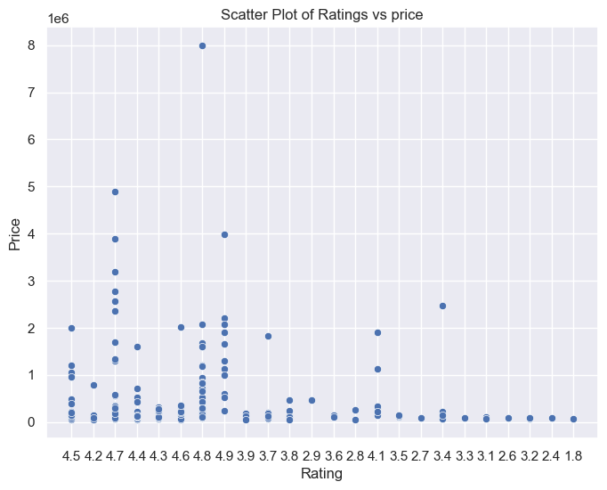
Positive Correlation between Ratings and Price
Assuming higher-rated bikes tend
to have higher prices, we can expect
to see a positive correlation between
ratings and gross income. Bikes with
better ratings are likely to command
premium prices, reflecting their
perceived value and quality compared
to lower-rated counterparts.

Slide 17
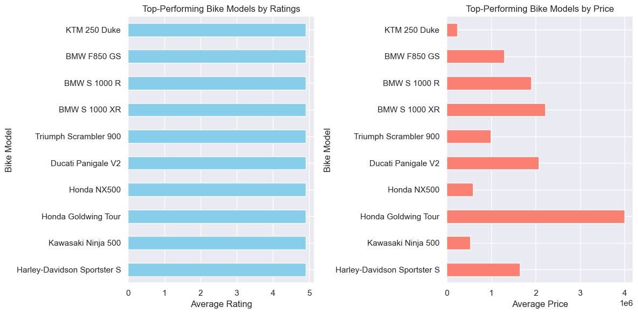
Top-Performing Bike Models
[HONDA GOLDWING TOUR]:This model has consistently received high ratings from customers, reflecting its superior design, performance, and value proposition. With its impressive
features and stellar reputation, it has secured a prominent position in the market.
2. [BMW S 1000]: Known for its exceptional build quality and innovative features, this bike has garnered widespread acclaim among riders. Its popularity is evident from its strong sales performance
and positive customer feedback.
3. [DUCATI PANIGALE V2]:With its combination of style, performance, and reliability, this model has emerged as a favorite among riders seeking a
premium biking experience. Its premium pricing reflects its status as a top-tier offering in the market.

Slide 18
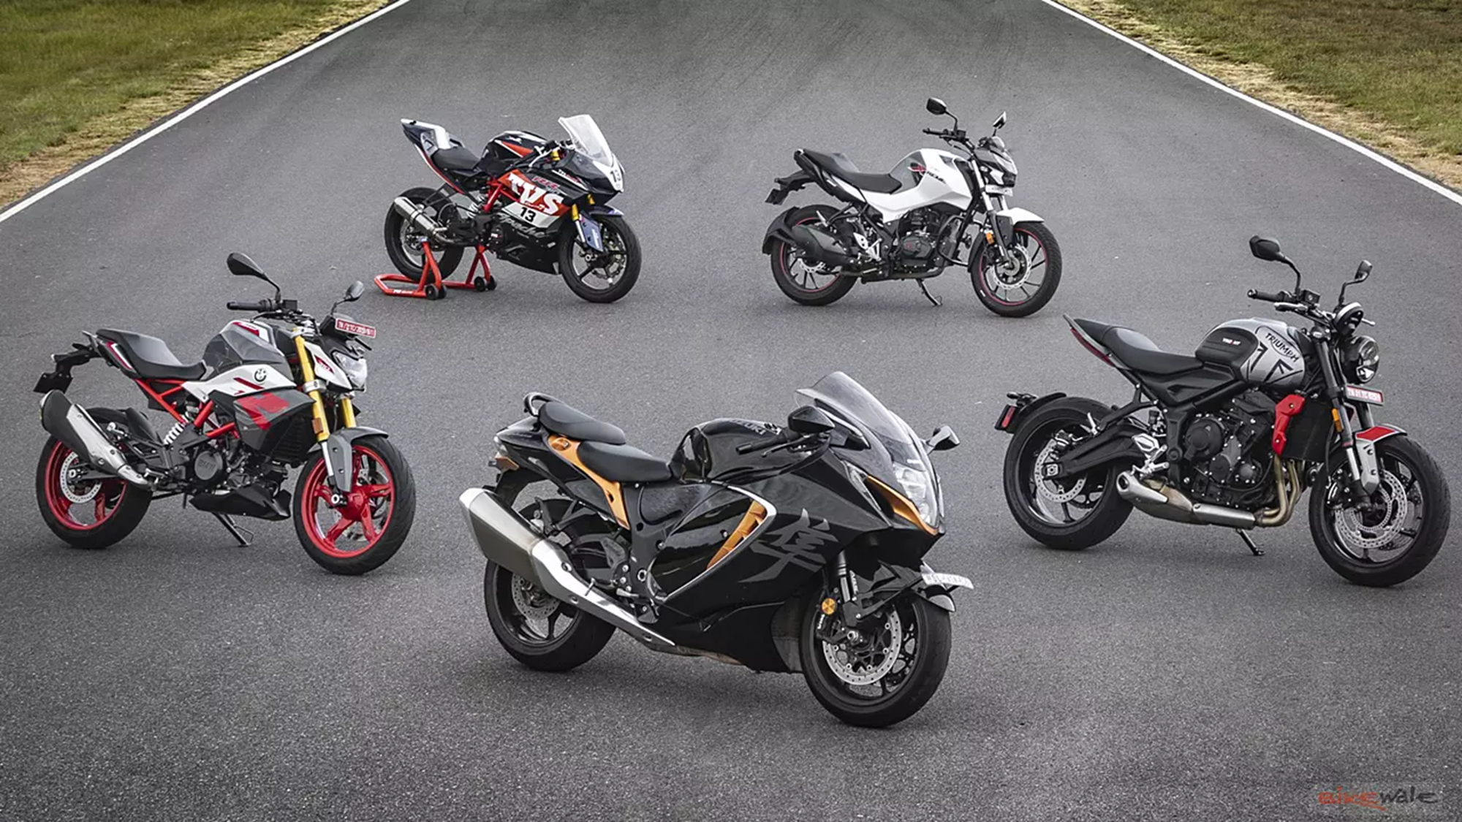
FINAL CONCLUSION OF THE ANALYSIS:
After analyzing the bike data, it's clear that higher-priced bikes tend to receive better ratings. This suggests that customers are willing to pay more for bikes they perceive as high-quality. The number of ratings also plays a role, with popular bikes often receiving higher ratings.
In simpler terms, if bike companies want to increase their sales and profits, they should focus on making bikes that customers love. This means building bikes that are not only well-made but also meet the expectations of their target market. By doing so, they can attract more customers and command higher prices for their bikes, ultimately leading to greater success in the market.
Further analysis may reveal that factors such as cubic capacity, kilometers per liter, horsepower, and weight influence both ratings and gross income. For example, bikes with higher cubic capacity or horsepower may appeal to performance enthusiasts and command higher prices, leading to better ratings overall.

Slide 19


